Slide 1
Mechanisms of Evolution

Slide 2
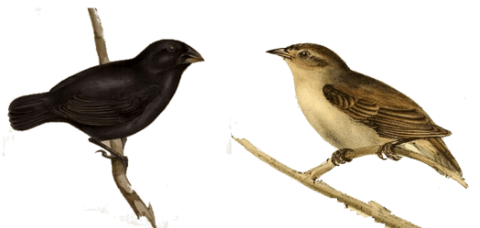
By the end of this lesson, you should be able to:
• | Describe natural selection, mutations, genetic drift and gene flow.
• | Understand how these processes drive evolutionary change.

Slide 3
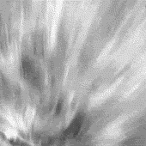
Evolutionary change can be encouraged by any process which alters the allele frequency in a population's gene pool.
There are four processes that can encourage evolutionary change:
• Natural Selection,
• Mutations,
• Gene Flow
and
• Genetic Drift.

Slide 4
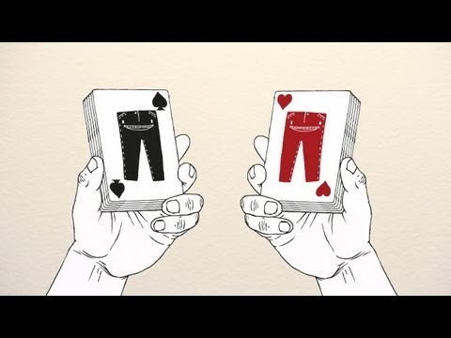

Slide 5
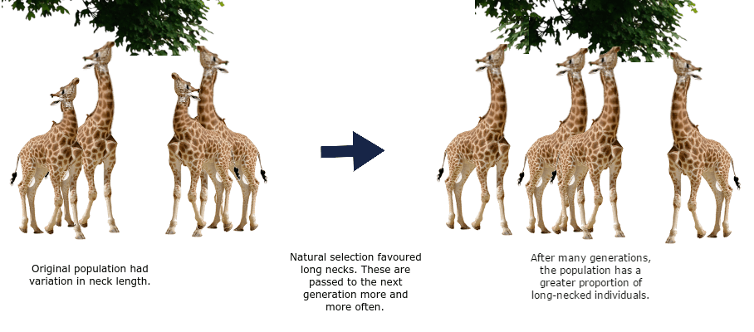
Natural selection is the increase or decrease in the frequency of certain alleles within a population.
The change in alleles may be caused by biotic (living) or abiotic (non-living) pressures.

Slide 6
Organisms with beneficial phenotypes will be better equipped to survive, reproduce, and, therefore, pass their advantageous genes on.
Over time, advantageous genes become more common in the gene pool.

Slide 7
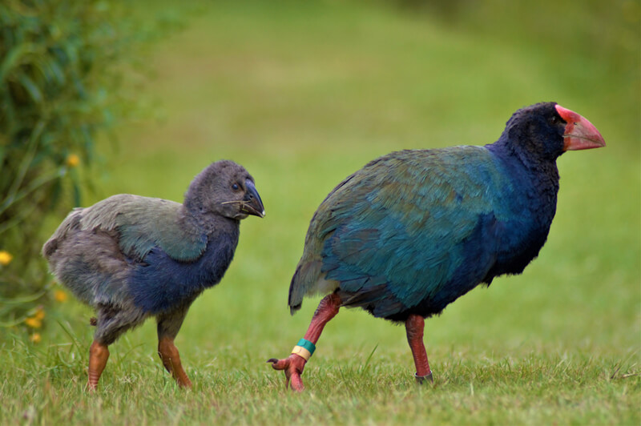
Natural selection can appear random, due to having no specific end goal aside from making organisms best suited to their environment.
It is a process in which an organism adapts (becomes better-suited to their environment), through nature selecting for genes that code for advantageous phenotypes.

Slide 8
A mutation is a change in an organism's genetic code, or DNA.
Sometimes, mutations can cause the protein they code for to change, leading to a change in the organism's phenotype.
Mutations that occur in gametes (sex cells) are the sole source of new alleles.

Slide 9
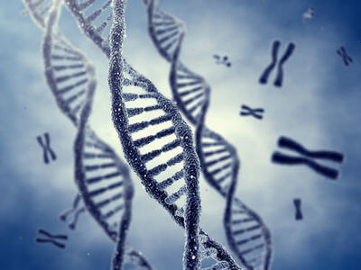
In much the same way as other alleles, mutations that are beneficial will be selected for. Organisms that have them will be more likely to survive, reproduce and pass these mutations on to the next generation.
Mutations may also be harmful. These will be selected against, as the organism is more likely to die before it gets a chance to reproduce.

Slide 10
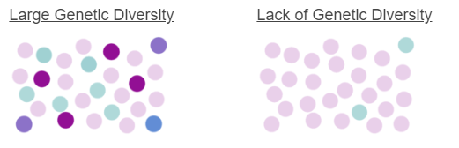
The role of mutations is to create variation within the gene pool, or genetic diversity.
This genetic diversity is what allows evolution to occur.
The role of natural selection is to produce adaptation to environmental conditions by increasing the frequency of advantageous genes in the gene pool.

Slide 11
This is because genetically diverse populations have a greater range of phenotypes, which increases the chance that at least some individuals will survive in the face of environmental change.

Slide 12

Now, let's go over gene flow and genetic drift!
These mechanisms can aid evolution by changing the frequency of alleles within a population's gene pool.

Slide 13
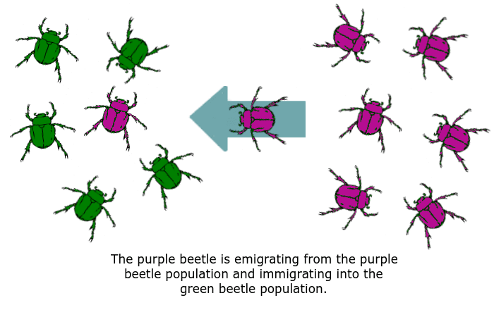
Gene flow is the addition or removal of alleles from a gene pool through immigration and emigration.
Immigration is when new organisms join a population and emigration is when members of a population leave.

Slide 14
In doing so, the purple beetle removes its alleles from the right-hand population and adds them to the left-hand population.
In the case of the left-hand population, the frequency of purple alleles thereby increases.

Slide 15
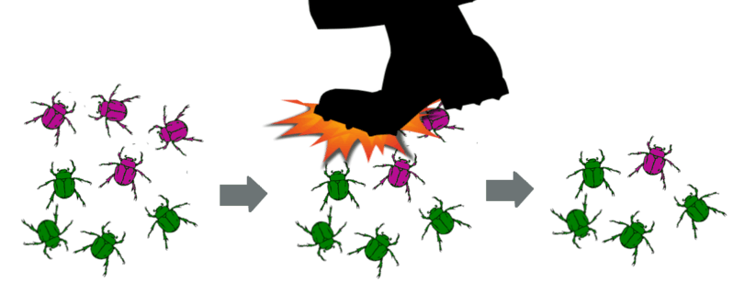
Genetic drift is the random change in the allele frequency of a population.
This can occur simply through the random pattern of mating or after a catastrophic event.
For example: a giant foot kills a proportion of purple beetles, reducing the frequency of the purple allele in the gene pool.

Slide 16
The gene pool has now changed.
Before the foot rudely stomped on the beetles, there were more purple alleles in the population.
The change in allele frequency means that evolution has occurred!

